Slide 1
Welcome to MATLAB DigComm LAB
  Matlab Toutrial
    http://www.math.utah.edu/lab/ms/matlab/matlab.html#starting
  LAB1 to LAB5 : BASIC WAVES
  LECTURE: Complex Exponential Function
    LAB6 to LAB7
  Channel Modeling
    LAB8
  OFDM modeling and Error Rate Measure
    LAB9 to LAB11
  REPORT TASK

Slide 2
LAB1： AM
Write Amplitude Modulation (AM) program by MATLAB
A = 1 + 0.5*cos(2*pi*1*t)
fc =5Hz
Use Sampling frequency fs = 100Hz

Slide 3
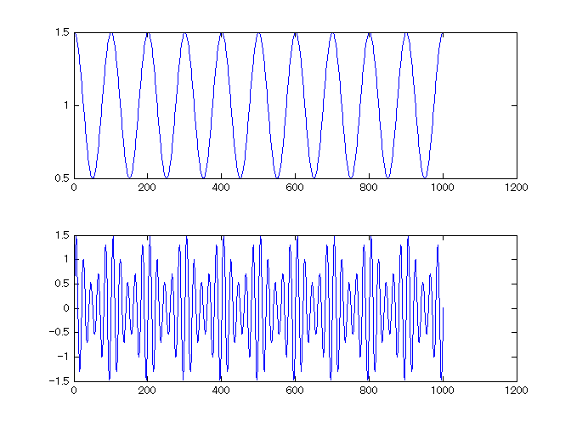
LAB1： AM answer
n=0:1000; % 1001 points
fc=5;
fs=100; % Sampling Frequency
t = n/fs; % time index
% INPUT to Modulator
A = 1 + 0.5*cos(2*pi*1*t);
% OUTPUT
x = A .* sin(2*pi*fc*t);
% FIGURE
figure(1);
subplot(2,1,1);
plot(A);
subplot(2,1,2);
plot(x);

Slide 4
LAB2: AM Demodulation
Use LAB1 result x and calculate y as each x is squared.
If you connect each peak of y, you can recover original A.

Slide 5
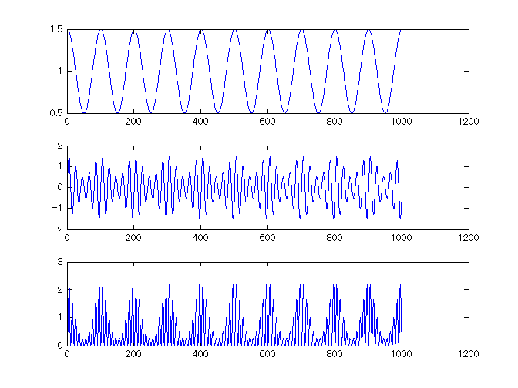
LAB2： AM Demod answer
n=0:1000; % 1001 points
fc=5;
fs=100; % Sampling Frequency
t = n/fs; % time index
% INPUT to Modulator
A = 1 + 0.5*cos(2*pi*1*t);
% OUTPUT
x = A .* sin(2*pi*fc*t);
%%
y = x .* x;
% FIGURE
figure(2);
subplot(3,1,1);
plot(A);
subplot(3,1,2);
plot(x);
subplot(3,1,3);
plot(y);

Slide 6
LAB3： Spectrum of square wave
Analyze below pulse spectrum by Discrete Fourier Transform.
0
1
0
1
0
1
0
1

Slide 7
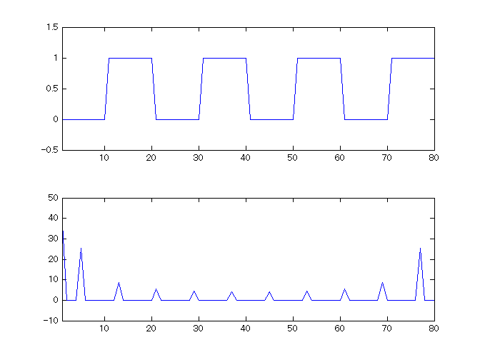
LAB3： Spectrum answer
Assume T = 10 points
n=1:1:80;
x = [zeros(1,10), ones(1,10), zeros(1,10), ones(1,10), zeros(1,10), ones(1,10), zeros(1,10), ones(1,10)];
figure(3)
subplot(2,1,1);
plot(x);
axis([1,80,-0.5, 1.5]);
%%
y = fft(x);
subplot(2,1,2);
plot(abs(y));
axis([1,80,-10, 50]);

Slide 8
LAB4： BPSK waveform
Make BPSK waveform as follows
When data=0
When data=1

Slide 9
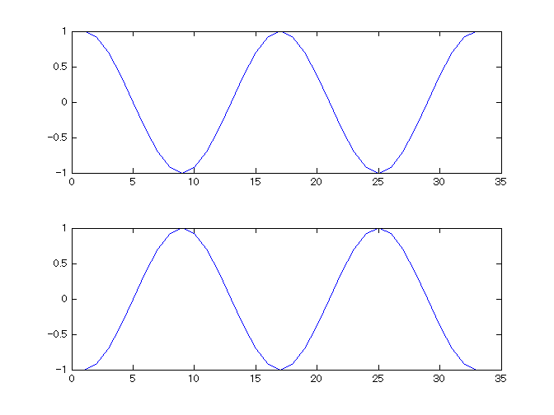
LAB4： BPSK answer
n=0:32;
fc=2;
fs=32; % Sampling Frequency
t = n/fs; % time index
% BPSK waveform
x0 = cos(2*pi*fc*t);
x1 = cos(2*pi*fc*t + pi);
% FIGURE
figure(5);
subplot(2,1,1);
plot(x0);
subplot(2,1,2);
plot(x1);
(A1, θ1)
=(1, π)
(A0, θ0)
=(1, 0)
0

Slide 10
LAB5： QPSK waveform
Make QPSK waveform as follows
(A1, Φ 1)
=(1, 3π/4)
(A0, Φ 0)
=(1, 1π/4)
(A2, Φ 2)
=(1, 5π/4)
0
(A2, Φ 2)
=(1, 7π/4)

Slide 11
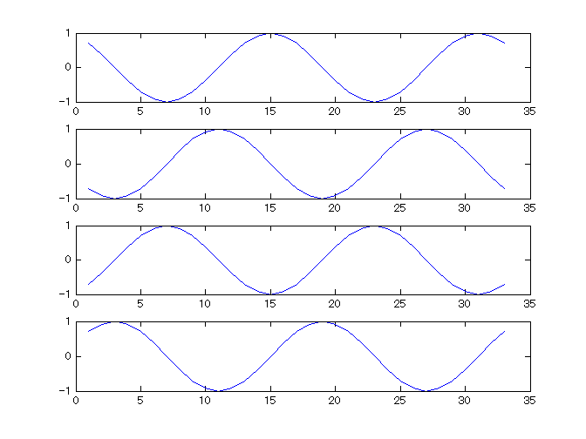
LAB5： QPSK answer
n=0:32;
fc=2;
fs=32; % Sampling Frequency
t = n/fs; % time index
% QPSK waveform
x0 = cos(2*pi*fc*t + 1*pi/4);
x1 = cos(2*pi*fc*t + 3*pi/4);
x2 = cos(2*pi*fc*t + 5*pi/4);
x3 = cos(2*pi*fc*t + 7*pi/4);
% FIGURE
figure(5);
subplot(4,1,1);
plot(x0);
subplot(4,1,2);
plot(x1);
subplot(4,1,3);
plot(x2);
subplot(4,1,4);
plot(x3);

Slide 12
LECTURE:
Complex Exponential Function

Slide 13
1. Complex Exponential Function
We will shift from SIN and COS to
Complex Exponential Function.
Real part
Imaginary part
Real and Imaginary =complex number
Real part is same as previous cosine wave.

Slide 14
2. Real – Imaginary plane
IQ plane
  I: In-Phase = Real axis
  Q: Quadrature-Phase = Imaginary axis
Real-Imaginary plane (Complex plane)
  Complex number can be indicated as a point
Imaginary axis (Q)
Complex plane
a + j b
b
Real axis (I)
0
a

Slide 15
Complex Exponential Function Shows Rotation in I-Q plane
Real part
Imaginary
Imaginary (Q)
A
Real (I)
0

Slide 16
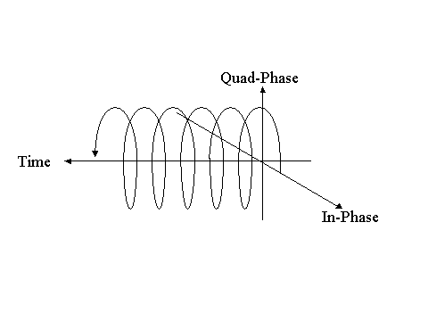
Complex Exponential Function shows Rotation on TIME!

Slide 17
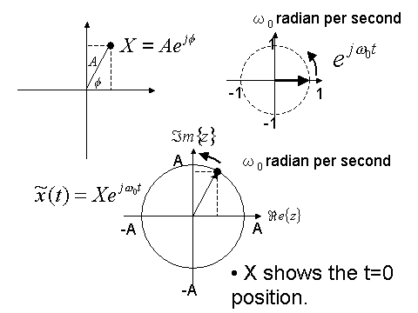
Complex Amplitude (Phaser)
X=x(t=0) shows
starting point (t=0) .
X is called as
Complex Amplitude (Phaser)

Slide 18
QPSK by Complex Exponential Function
Imaginary (Q)
Real (I)
0
Complex Amplitude (Phaser) = Constellation point

Slide 19
Conversion from Complex Exponential Function to Real sinusoid.
Take Real Part
Then
You can convert!

Slide 20
LAB6： QPSK waveform
Make QPSK waveform as follows using
(A1, Φ 1)
=(1, 3π/4)
(A0, Φ 0)
=(1, 1π/4)
(A2, Φ 2)
=(1, 5π/4)
0
(A2, Φ 2)
=(1, 7π/4)

Slide 21
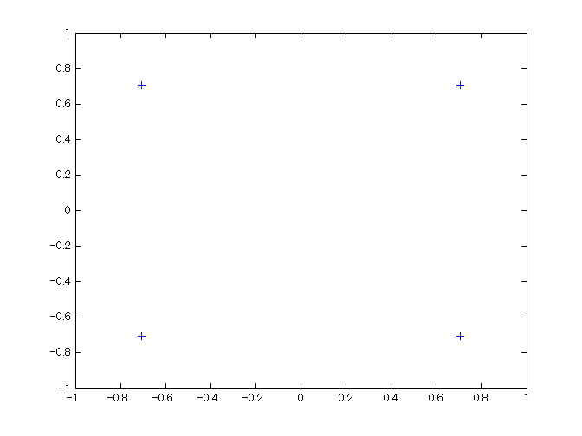
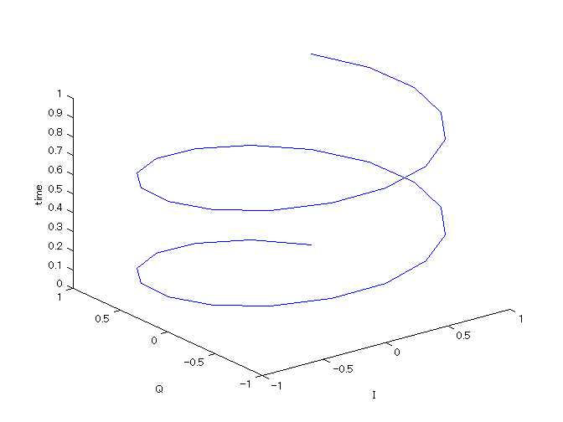
LAB6： QPSK (2) answer
n=0:32; fc=2;
fs=32; % Sampling Frequency
t = n/fs; % time index
% QPSK Phasers
X0 = exp(1j*1*pi/4); X1 = exp(1j*3*pi/4);
X2 = exp(1j*5*pi/4); X3 = exp(1j*7*pi/4);
% FIGURE
figure(61); plot([X0, X1, X2, X3], '+');
axis([-1 1 -1 1]);
%
X0wave = X0 * exp(1j*2*pi*fc*t); X1wave = X1 * exp(1j*2*pi*fc*t);
X2wave = X2 * exp(1j*2*pi*fc*t); X3wave = X3 * exp(1j*2*pi*fc*t);
%
figure(62);
XX=real(X0wave); YY=imag(X0wave); ZZ=t;
plot3(XX, YY, ZZ); xlabel ('I'); ylabel('Q'); zlabel('time');
%
figure(63);
subplot(4,1,1); plot(real(X0wave));
subplot(4,1,2); plot(real(X1wave));
subplot(4,1,3); plot(real(X2wave));
subplot(4,1,4); plot(real(X3wave));

Slide 22
LAB7： Draw BER graph
Make following graph by MATLAB

Slide 23
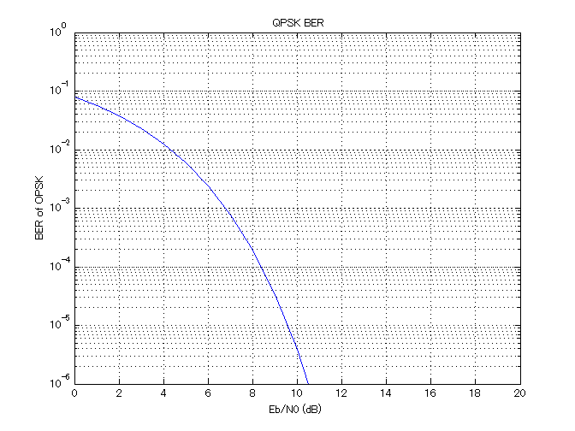
LAB7： BER graph answer
EBN0dB = 0:1:20; % EbN0 in dB
EBN0 = 10 .^(EBN0dB/10);
BER_QPSK = 0.5*erfc(sqrt(EBN0));
figure(7);
semilogy(EBN0dB, BER_QPSK);
axis([0 20 1E-6 1]);
xlabel(' Eb/N0 (dB) ');
ylabel(' BER of OPSK');
grid on;
title(' QPSK BER');

Slide 24
LECTURE:
Channel Modeling

Slide 25
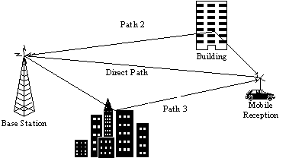
Multipath Channel
Direct path and Delayed paths

Slide 26
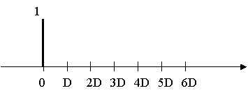
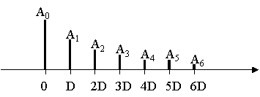
Channel Modeling by Impulse Response
Sending Signal
H(z)
Receiving
Signal
If sending signal is Impulse
then, Received signal has many
delayed components.
This outputs shows
CHANEL IMPULSE RESPONSE

Slide 27


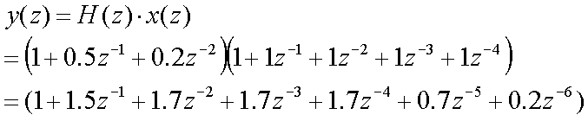
Convolution operation
If you multiply two polynomial
Channel Impulse Response=(1, 0.5, 0.2)
Send (1, 1, 1, 1, 1) signal
Then Received Signal is (1,1.5,1.7,1.7,1.7,0.7,0.2)

Slide 28
Channel Modeling by Impulse Response
(1, 1, 1, 1, 1)
(1,1.5,1.7,1.7,1.7,0.7,0.2)
Sending Signal
H(z)
Receiving
Signal
H(z) =(1, 0.5, 0.2)
This can be calculated by CONVOLUTION.

Slide 29
LAB8： CHANNEL
Assume Channel Impulse Response =
(1, 0.5, 0.2)
Show each received signal for
  x1 = [1,0,0,0,0,0,0];
  x2 = [1,1,1,1,1,0,0];
  n = 1:100; x3 = cos(2*pi*n/32);

Slide 30
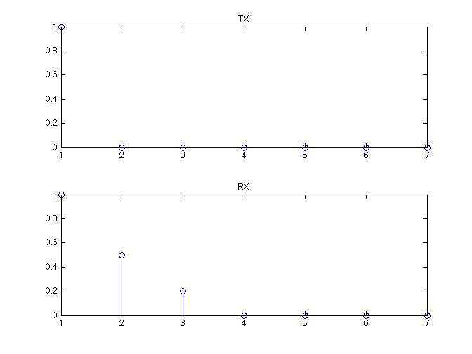
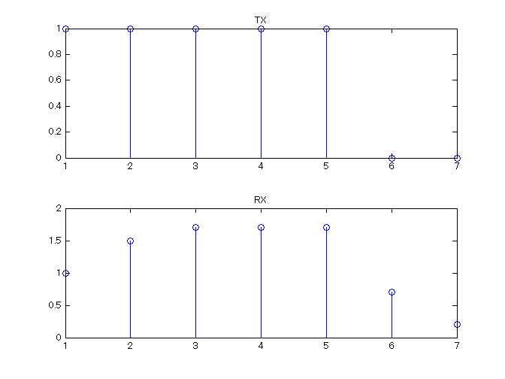
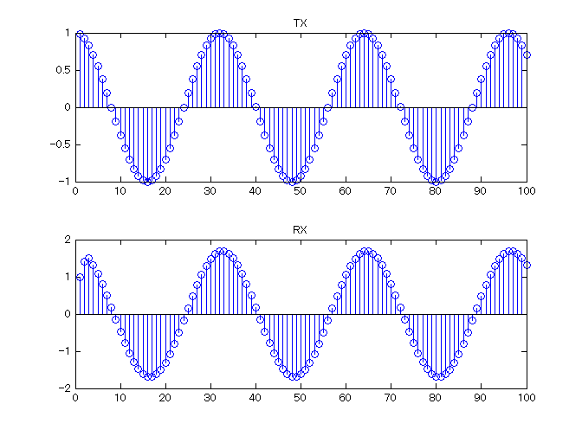
LAB8： CHANNEL answer
%% CHANNEL
h = [1, 0.5, 0.2];
%% INPUT signal 1
x1 = [1,0,0,0,0,0,0];
y1 =conv(h, x1); % OUTPUT signal
figure(81)% FIGURE
xa=1:7;
subplot(2,1,1); stem(xa, x1(1:7)); title('TX');
subplot(2,1,2); stem(xa, y1(1:7)); title('RX');
%% INPUT signal 2
x2 = [1,1,1,1,1,0,0];
y2 =conv(h, x2); % OUTPUT signal
figure(82)% FIGURE
xa=1:7;
subplot(2,1,1); stem(xa, x2(1:7)); title('TX');
subplot(2,1,2); stem(xa, y2(1:7)); title('RX');
%% INPUT signal 3
n = 1:100; x3 = cos(2*pi*n/32);
y3 =conv(h, x3);% OUTPUT signal
figure(83)% FIGURE
xa=1:100;
subplot(2,1,1); stem(xa, x3(1:100)); title('TX');
subplot(2,1,2); stem(xa, y3(1:100)); title('RX');

Slide 31
LECTURE:
OFDM Modeling

Slide 32
OFDM digital communication WORK SHEET
We are going to send 8bits by the following OFDM communication system
④
G
I
add
u₃
u₀
u₀
u₃
u₀
u₁
u₂
u₃
①
00
②
M
A
P
d₀=1+j
③
I
F
F
T
01
d₁=-1+j
u₁
u₁
00011011
10
d₂=1-j
u₂
u₂
11
d₃=-1-j
u₃
u₃
GI
OFDM
Q
01
00
I
11
10
u₃
⑤
G
I
rmv
u₀
u₀
⑥
F
F
T
d₀=1+j
⑦
De
M
A
P
00
⑧
u₁
u₁
d₁=-1+j
01
d₂=1-j
00011011
u₂
u₂
10
u₃
u₃
d₃=-1-j
11

Slide 33
LAB9 OFDM
Please draw OFDM symbol complex wave form including GI when you send “00011011”.
Please draw OFDM symbol complex wave form including GI when you send “10010011”.
Please draw OFDM symbol complex wave form including GI when you send “00000000”.
Compare those 3 waveform. Then Did you find any problem? If yes, please state the problem.
I
Effective Symbol
GI
Time
Q
Time

Slide 34
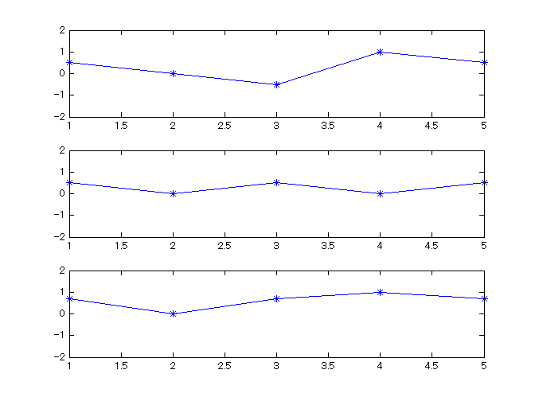
LAB9 1) answer
%%
data=[0,1,2,3]; % 0->00, 1->01, 2->10, 3->11
% MAP
modqpsk= [1+i, -1+i, 1-i, -1-i];
const =modqpsk(data+1);
% IFFT
uu = ifft(const);
% GI ADD
uu_g =[uu(4), uu];
% FIGURE
figure(81)
subplot(3,1,1); plot(real(uu_g),'*-'); axis([1 5 -2 2]);
subplot(3,1,2); plot(imag(uu_g),'*-'); axis([1 5 -2 2]);
subplot(3,1,3); plot(abs(uu_g),'*-'); axis([1 5 -2 2]);

Slide 35
LAB10 OFDM
MAKE 100 symbol OFDM signal based on previous 4 point OFDM + 1 point GI.
Add noise of SNR=10dB

Slide 36
LAB10 OFDM answer
%% 4. GI add
data_4 = [data_3(n_symbol,:);data_3];
%%4.1 Add Noise
sigpower=mean(mean(abs(data_4).^2));
sn= 10; %% 10dB
awgn = (randn(n_symbol+1,num_symbol)+i*randn(n_symbol+1,num_symbol));
awgnpower=mean(mean(abs(awgn).^2));
awgn = awgn/sqrt(awgnpower)*10^(-sn/20)*sqrt(sigpower);
data_4=data_4+awgn;
subplot(2,2,3);
plot(real(data_4),'-');
title('GI add');
%% 5. GI remove
data_5 = data_4(2:n_symbol+1,:);
%% 6. FFT
data_6 = fft(data_5);
subplot(2,2,4);
plot(data_6,'b.');
axis([-3 3 -3 3])
title('receive data constellation')
figure(200)
plot(real(reshape(data_4,(n_symbol+1)*num_symbol,1)));
% Simple OFDM system (send 8 bits/symbol * 100 symbol)
% Fire Wada
clear all;
num_symbol = 100; % number of symbols
n_symbol = 4; % points in symbol
M = 4; % size of signal constellation
modqpsk= [1+i, -1+i, 1-i, -1-i];
%% 1 . create random data
data = floor(rand(n_symbol,num_symbol)*M);
%% 2. mapping into I-Q constellation
data_1 = modqpsk(1+data);
figure(100);
subplot(2,2,1);
plot(data_1,'r.');
axis([-3 3 -3 3])
title('data constellation')
data_2 = data_1;
%% 3. IFFT
data_3 = ifft(data_2);
subplot(2,2,2);
plot((real(data_3)),'-');
title('IFFT');

Slide 37
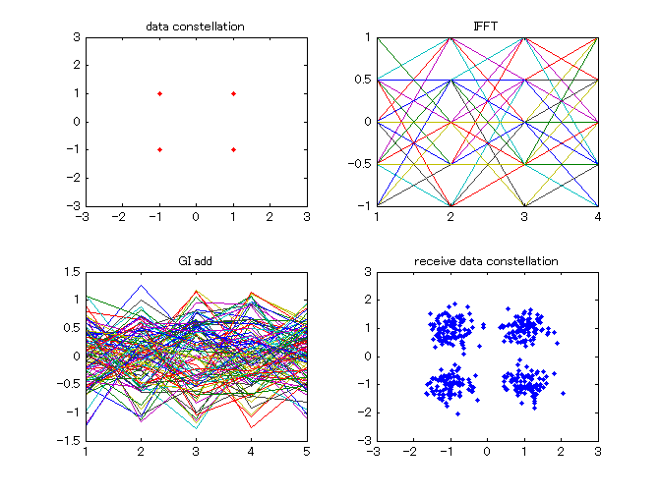
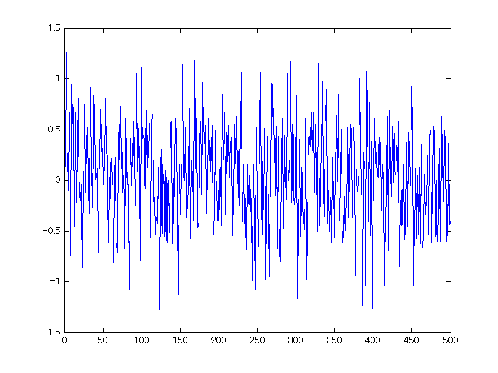
LAB10 OFDM answer

Slide 38
LAB11 Symbol Error Rate
Measure Symbol Error Rate for LAB10.
Add noise of SNR=0dB, 5dB, 10dB.
Use ‘demapQPSK.m’ function.
Put the m-file in same directory.
% demapQPSK.m
% The program demap to Complex to Numerical data.
function graycode = demapQPSK(comp)
re = real(comp);
im = imag(comp);
if (re >= 0 & im >= 0 ) graycode=0;
elseif (re < 0 & im >= 0 ) graycode=1;
elseif (re >= 0 & im < 0 ) graycode=2;
else graycode=3;
end

Slide 39
LAB11 Symbol Error Rate
% Simple OFDM system (send 8 bits/symbol * 100 symbol)
% Fire Wada
clear all;
num_symbol = 100; % number of symbols
n_symbol = 4; % points in symbol
M = 4; % size of signal constellation
modqpsk= [1+i, -1+i, 1-i, -1-i];
%% 1 . create random data
data = floor(rand(n_symbol,num_symbol)*M);
%% 2. mapping into I-Q constellation
data_1 = modqpsk(1+data);
data_2 = data_1;
%% 3. IFFT
data_3 = ifft(data_2);
%% 4. GI add
data_4 = [data_3(n_symbol,:);data_3];
%%4.1 Add Noise
sigpower=mean(mean(abs(data_4).^2));
sn= 5; %% 10dB
awgn = (randn(n_symbol+1,num_symbol)+i*randn(n_symbol+1,num_symbol));
awgnpower=mean(mean(abs(awgn).^2));
awgn = awgn/sqrt(awgnpower)*10^(-sn/20)*sqrt(sigpower);
data_4=data_4+awgn;
%% 5. GI remove
data_5 = data_4(2:n_symbol+1,:);
%% 6. FFT
data_6 = fft(data_5);
figure(11)
plot(data_6,'b.');
axis([-3 3 -3 3])
title('receive data constellation')
%% 7. recover data
rdata=zeros(n_symbol,num_symbol);
for sym = 1: num_symbol
for index = 1:n_symbol
rdata(index, sym) = demapQPSK(data_6(index,sym));
end
end
%% 8. measure Symbol Error Rate by compare data and rdata
Total_data= n_symbol*num_symbol;
diff = rdata - data;
% count how many not zero in diff
notZero = (diff ~= 0);
Total_error=sum(sum(notZero));
fprintf('*** SNR =%4.2f, *** SYMBOL ERROR RATE = %8.5f *** \n', sn, Total_error/Total_data);

Slide 40
TASK1
Make a Matlab program to measure Symbol Error Rate vs SN ratio
in 1K OFDM with QPSK modulation
  FFT size = 1024 points in 1 symbol
  GI length = 1/8*FFT size = 128 points
  Total 100 symbol
Write Mid Report to explain OFDM simulation including
Your Matlab program
Total 100 symbol waveform
Consternation with SNR=0, 3, 6, 9dB
Symbol Error Rate vs SNR Graph
  Vertical: SER in log scale
  Horizontal: SN ratio 0dB, 1dB … to 10dB

