Slide 1
Extracting features from image
and
Converting image into Ascii Art
Member
128568J Yu Taninari
128572G Shigehisa Kyoda
128585J Shuichi Tamayose

Slide 2
OUTLINE
Abstract
Edge Detection
Font
Ascii Art
Conclusion

Slide 3
Abstract
We use AA on Internet World today.
Do you know AA ?
AA is “Ascii Art “.
It is easy to understand web contents when I know AA .
Therefore ,
We can enjoy net surfing !!!

Slide 4
Edge Detection
To make AA ,
First ,
convert image into image detected edge in .
Next ,
convert its image into AA .

Slide 5
Edge Detection
Unsharp masking
Sobel filter ( detect the vertical and horizon )
Search concentration factor of combine the vertical and horizon image
This image is divided in half color (white and block color by Threshold )

Slide 6
Unsharp masking
Original
Sharp

Slide 7
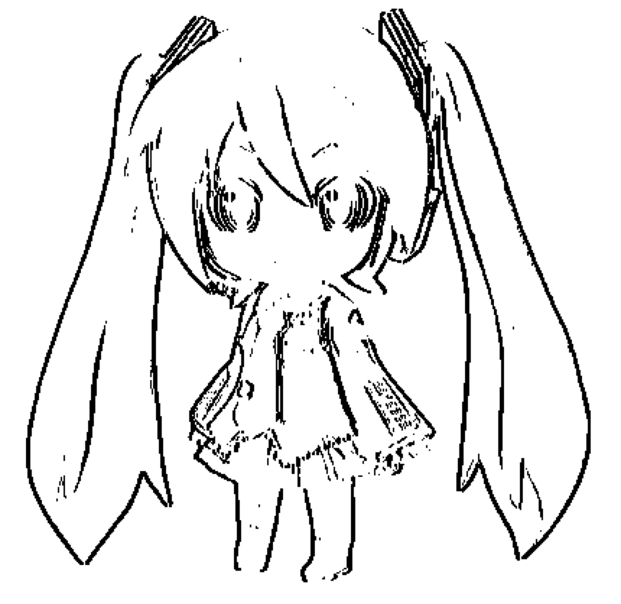
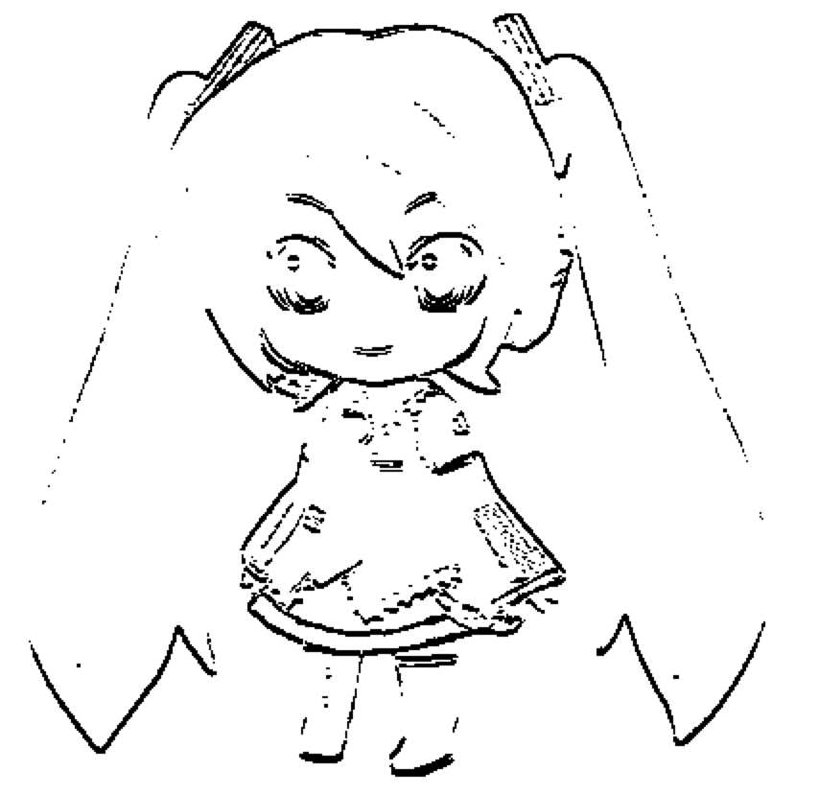
Sobel Filter
Vertical
Horizon

Slide 8
Edge Detection
Sharp
Edge detection

Slide 9
Ascii Art

Slide 10
Font Table

Slide 11
Algorithm
Get 1 block (5 x 5 pixel)
Compare with the value in Font Table
Put a character
Next block

Slide 12
Ascii Art

Slide 13
Future
Javascript ( web browser )
Auto Resize
Add a character to Font Table
Improve an Evaluation algorithm

Slide 14
Conclusion
Notes:
Thank you for attention !

