Slide 1
Image enhancement by Morphology Edge Detection and Highlighting

Slide 2
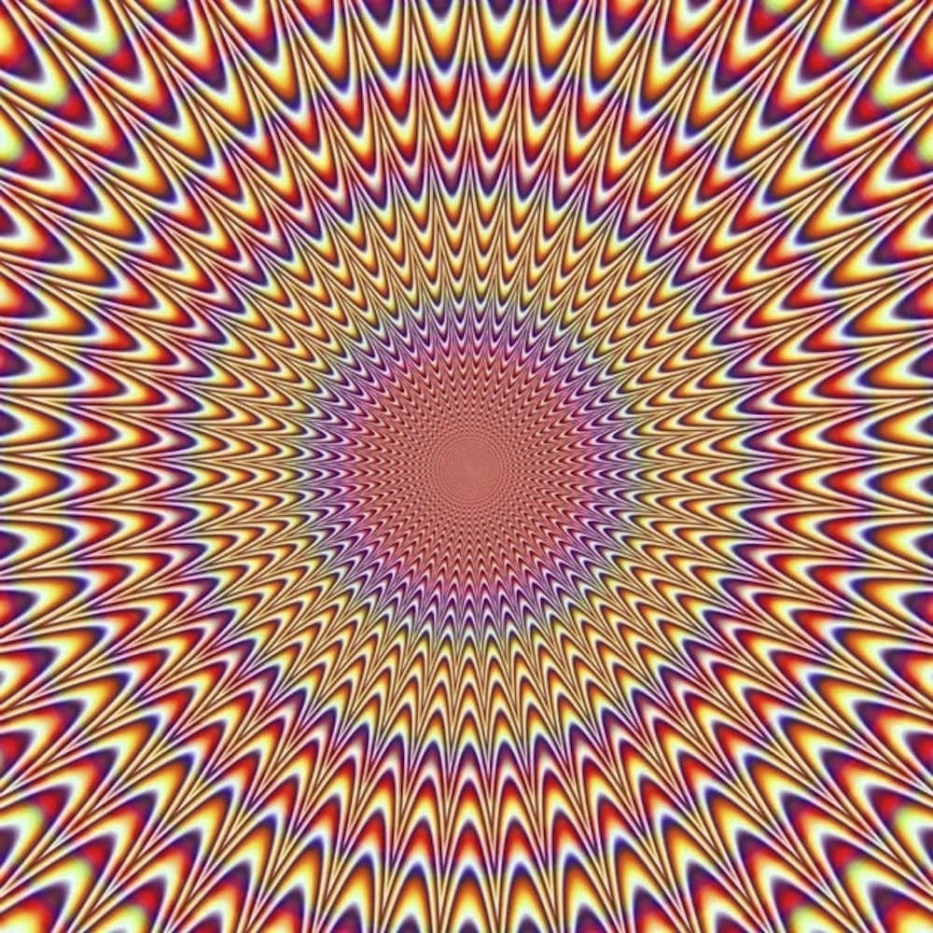
Illusion aided vision Illusion is coming from our mind, but it helps us much to have and enhanced view to the subjects.

Slide 3
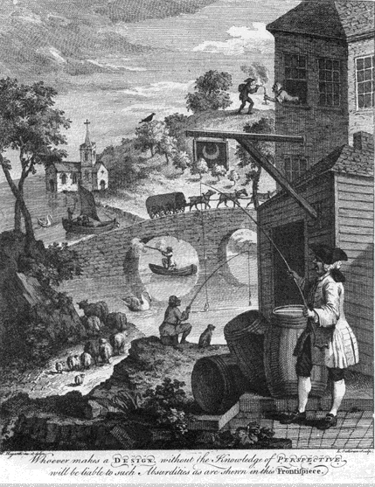
William Hogarth
1754 - "Whoever makes a DESIGN without the knowledge of PERSPECTIVE will be liable to such Absurdities as are shown in this Frontispiece."
Source: W. Hogarth, 1697-1764 Trustees of the British Museum.

Slide 4
Eye-Movement Theory
Line length ←→ eye movement
Testable, but usually fails – initial perception, eyes are stable
Finding an index of eye movements a problem

Slide 5
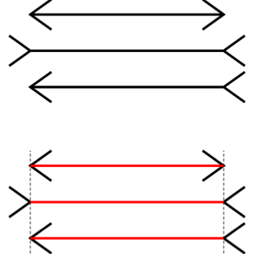
Müller-Lyer Lines
Eye-movement theory: Arrowheads influence extent of eye movements

Slide 6
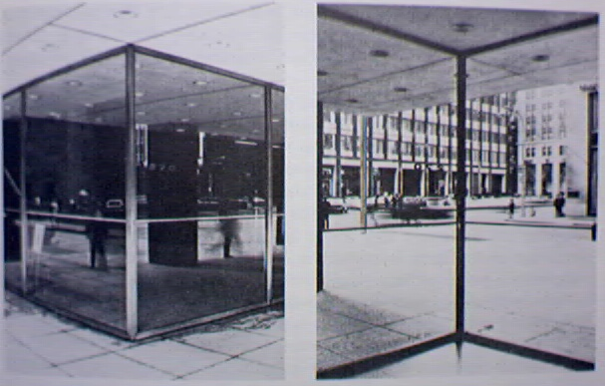
Müller-Lyer Lines Revisited
The same illusion through perspective cues
Oculomotor Macropsia/Micropsia

Slide 7
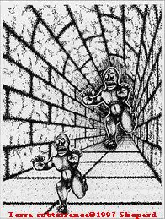
Of Giants and Dwarves?

Slide 8
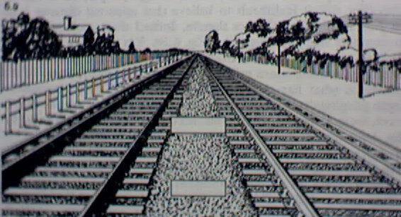
relative size of elements, separation, density, clarity, background

Slide 9
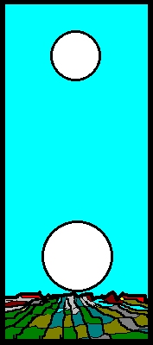
The Moon Illusion
Perceived distance, visual angle, & linear size != physical values
Illusion from comparison of perceived values at the horizon & at the zenith
Subtends .5º in the eye no matter what
Not atmospheric
Illusion disappears in a “mooning position” ☺

Slide 10
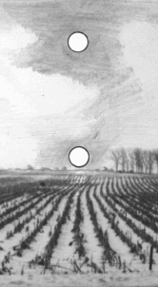
Apparent distance theory – appears farther away → larger
Size-distance paradox
Distance, visual angle, & linear size illusions work together
Oculomotor micropsia / macropsia → visual angle
Distance cues → macropsia for horizon moon

Slide 11
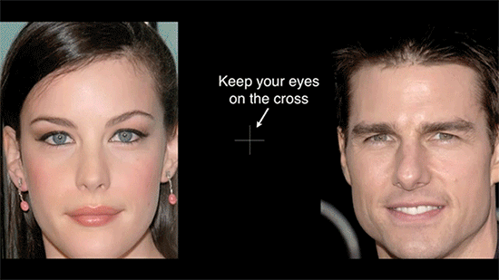
Look at the cross, how do the celebrities look?

Slide 12
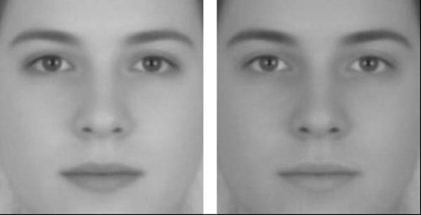
Which face is male and which is female?
… wrong, they’re the same androgynous face.

Slide 13
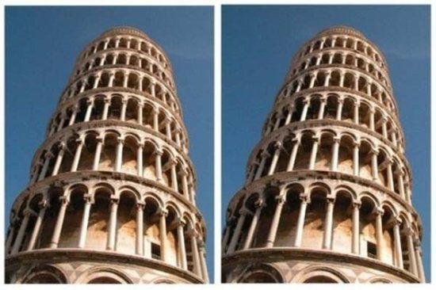
Is this the same picture?
YES

Slide 14
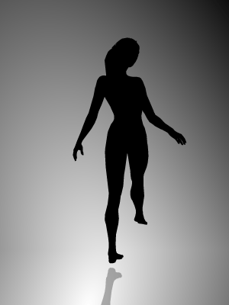
Which direction is she spinning? Are you sure?

Slide 15
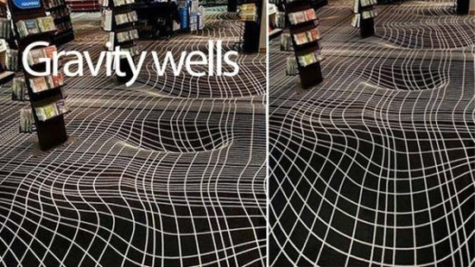
This floor is flat.

Slide 16
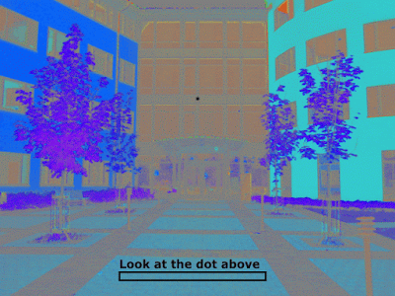

Slide 17
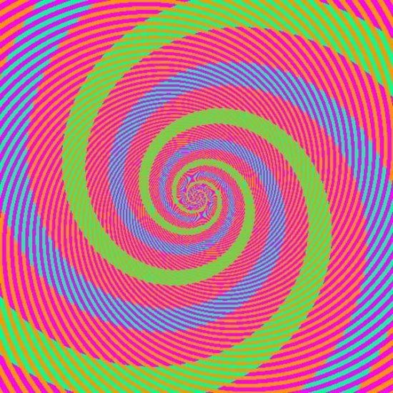
The blue and green spirals…they are exactly the same color.

Slide 18
Try to focus on one dot. … … Do you see the black dots?

Slide 19
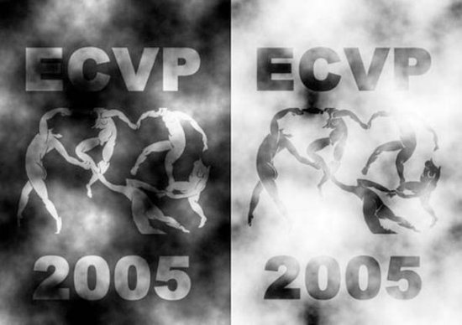
These two sets of figures are the same color

Slide 20
Which orange dot is bigger size?
They are the same in size! ☺

Slide 21
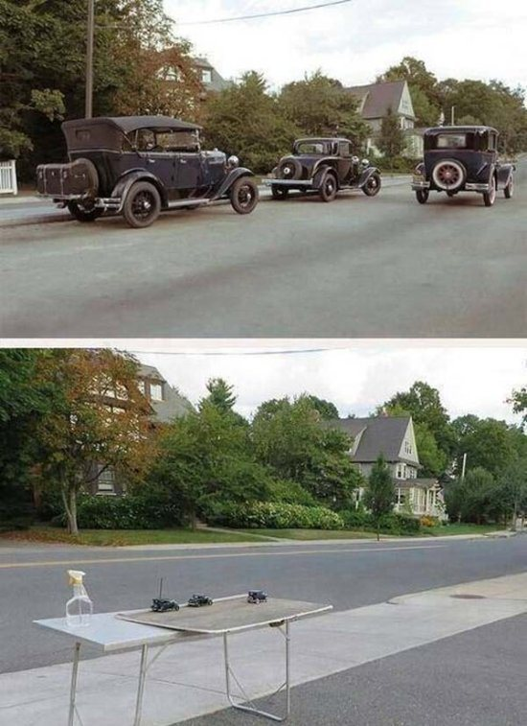

Slide 23
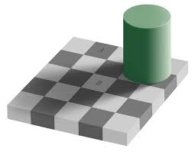
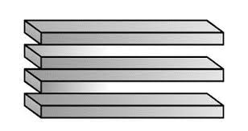
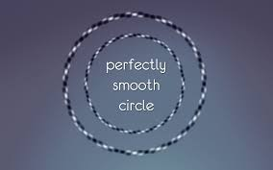
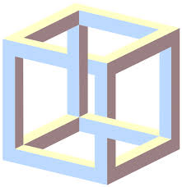
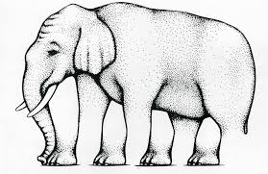
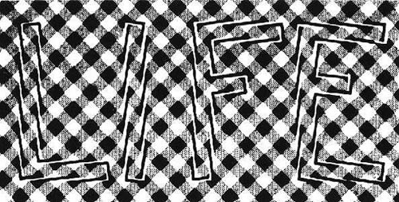
So on

Slide 24
Image enhancement by Morphology Edge Detection and Highlighting

Slide 25
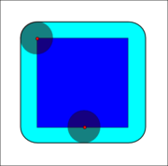
Basic Operation [Dilation]
Dilation
Operation that “grows” or “thickens” objects in a binary image.
Dilation
Sample Image
Structuring Element

Slide 26
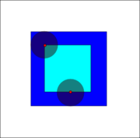
Basic Operation [Erosion]
Erosion
Operation that “shrinks” or “thins” objects in a binary image.
Erosion
Sample Image
Structuring Element

Slide 27
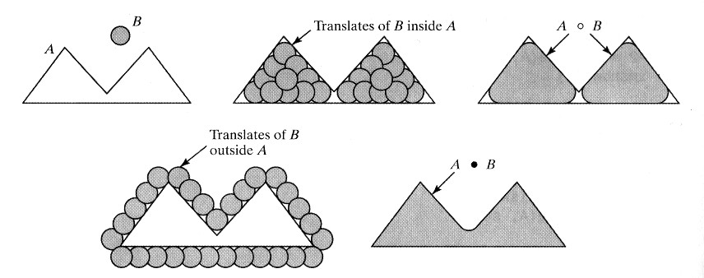
Opening and Closing
Opening
Closing

Slide 28
Edge Detection using Morphology
Original image
erosion
Threshold
Edge
Difference

Slide 29
Edge Highlighting

Slide 30
Understanding human perception by human-made illusions
http://journal.frontiersin.org/article/10.3389/fnhum.2014.00566/full

Slide 31
Demonstration of the simultaneous contrast, an optical illusion already described as phenomenon 200 years ago by Johan Wolfgang von Goethe and provided in high quality and with an intense effect by McCourt (1982): the inner horizontal bar is physically filled with the same gray value all over, nevertheless, the periphery with its continuous change of gray from darker to lighter values from left to right induce the perception of a reverse continuous change of gray values.

Slide 32
Chevreul-Mach bands. Demonstration of contrast exaggeration by lateral inhibition: although every bar is filled with one solid level of gray, we perceive narrow bands at the edges with increased contrast which does not reflect the physical reality of solid gray bars.

Slide 33
Morphological highlighted edge
Normal edge
Morphological highlighted edge

